Slide 1
2014 AgrAbility National Training Workshop
Working With Your 1890 Institution
Sandra Thompson, M.Ed., EdS.
Community Resource Development, Faculty/Program Leader/Specialist
Florida A&M University
College of Agriculture and Food Sciences
Cooperative Extension Program

Slide 2
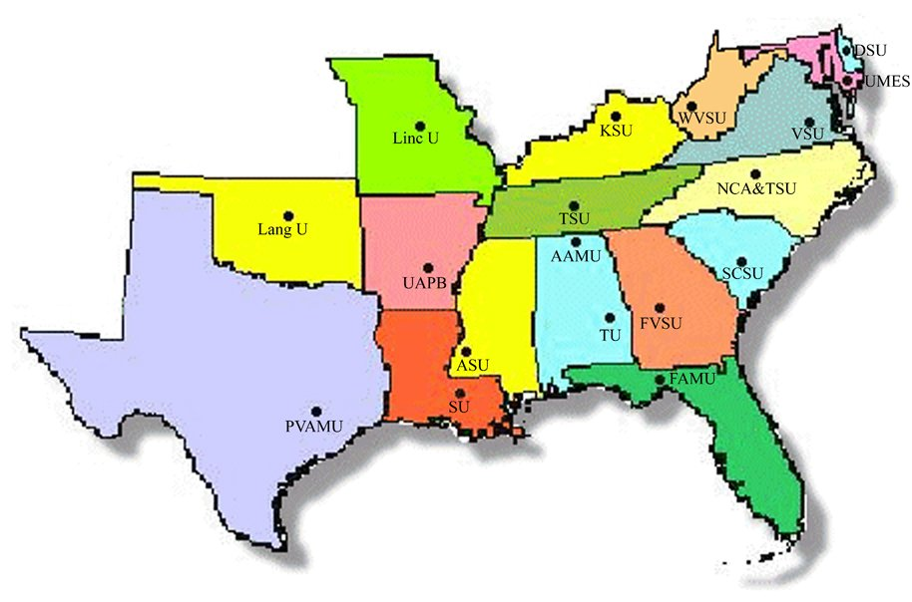
1890 Land Grant Institutions
Source: http://www.usawaterquality.org/funded_projects/facilitation/1890_Facilitation.html
http://www.pvamu.edu/library/about-the-library/history-of-the-library-at-prairie-view/1890-land-grant-history/

Slide 3
Performance
The 1890 institutions are prominent among research institutions in fields such as:
Animal sciences
Sustainable agriculture and agriculture economics
Toxicology and waste management
Conservation and environmental management
Business and industrial development
Biomedical science
Food and nutrition
Plant and social sciences
International development
Source: http://www.aplu.org/page.aspx?pid=1074

Slide 4
Contributions
Research to include:
Ways to boost the productivity of grain legumes—peanuts, soybeans, pigeon peas and dry beans—to help alleviate poverty in developing nations;
Synthesized a series of oxygen-carrying protein complexes that have the potential to serve as blood substitutes in the treatment of sickle cell anemia; and
Developed new composite alloys for use in space exploration.
Research facilities to include:
Centers for the application of remote sensing; biomedical; environmental technology; silicon fabrication; water resources engineering and food microbiology/nutrition
Claude E. Phillips Herbarium.
Source: http://www.aplu.org/page.aspx?pid=1074

Slide 5
Contributions
Three of Top Five Producers of African American Graduates with doctorate degrees:
Florida A&M University,
Tennessee State University and
Southern University & A&M College
Three of the largest historically black universities in the nation are land-grant institutions:
University of the District of Columbia
Florida A&M University
Southern University and A&M College
Source: http://www.aplu.org/page.aspx?pid=1074

Slide 6
Contributions
Doctorate and professional degree disciplines to included:
Engineering
Food Sciences
Law
Pharmaceutical Sciences
Physics
Plant and Soil Sciences
Toxicology
Veterinary Medicine
Applicable Universities - Alabama A&M University, Florida A&M University, North Carolina A&T State University, South Carolina State University, Southern University & A&M College, Tennessee State University, Tuskegee University and the University of Maryland Eastern Shore.
Source: http://www.aplu.org/page.aspx?pid=1074

Slide 7
Focus
Target Audience:
Primarily socially and economically disadvantaged populations in both urban and rural settings
Cooperative Extension Programming:
4-H and Youth Development
Community Resource Development
Agriculture
Natural Resource and Conservation
Family and Consumer Science
eXtension

Slide 8
Relevance
1890 Impact Small Scale Agriculture
Development of a Natural Hog Growers Association increased its membership hog-sale income by over $200,000 in North Carolina and entered into contracts with the Whole Food Market.
Development of the Master Meat Goat Herdsman Program has saved producers over $16,250, annually, in Florida in veterinarian and production costs.
In Alabama, as a result of efficiency training, 13 farmers acquired USDA farm ownership loans in the amount of $2.6 million and 10 acquired operating loans for nearly $1.0 million. Limited-resource farmers in Kentucky increased net farm income by $4,500.00.
Source: http://docs.house.gov/meetings/AG/AG14/20140304/101828/HHRG-113-AG14-20140304-SD004.pdf

Slide 9
Improving Capacity
The capacity of 1890 Institutions to offer AgrAbility training and consultation to residents with disabilities in their respective geographical service areas will
Create access to agricultural related pursuits
Improve overall quality of life
Create new stakeholder and networks invested in providing comprehensive service access
Promote social and economic justice

